Slide 1
Introduction to 8086 Microprocessor

Slide 2
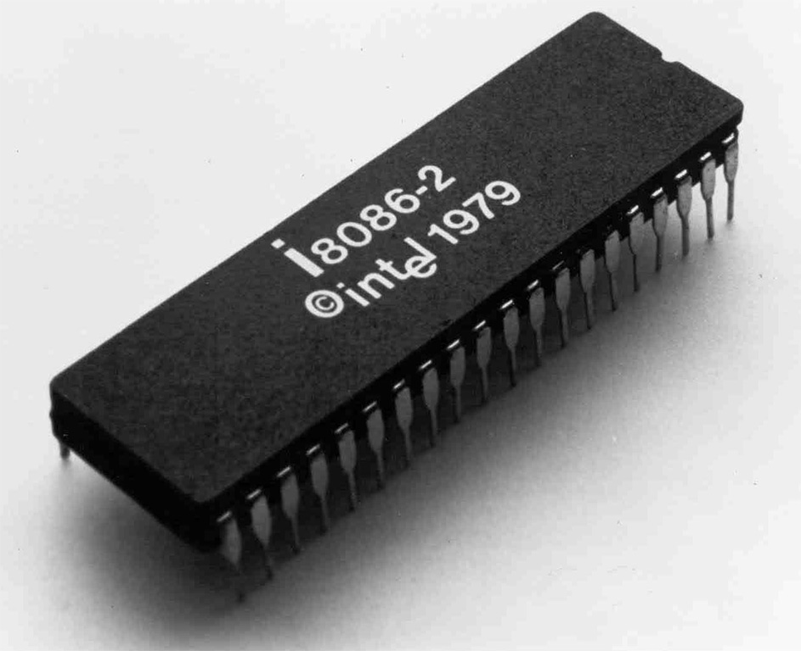

Slide 3
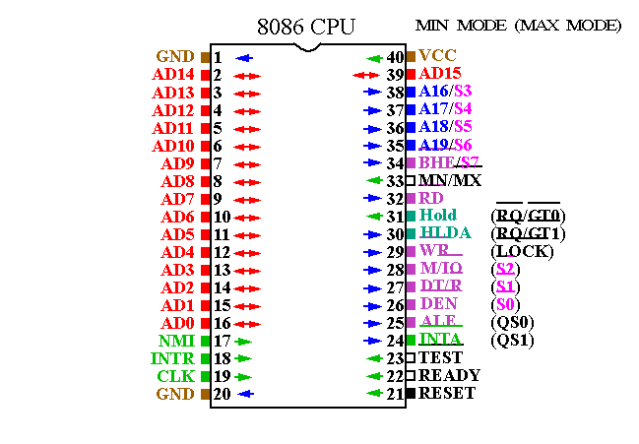
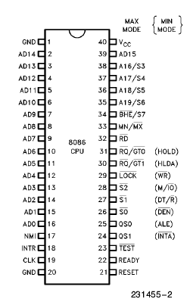
8086 Pin Diagram

Slide 4
Pin Description
AD0-AD15: Multiplexed Address/Data Bus
RD’: Low while reading from memory or port
WR’ : Low while writing to memory or port
ALE : Address latch enable shows 8086 data bus contains address information. This address can be a memory or I/O device
M/IO’ : High during Memory operations.
Low during I/O Port operations.
RESET: causes the processor to immediately terminate its present activity. The signal must be active HIGH for at least four clock cycles. It restarts execution.

Slide 5
Pin Description
CLK : The clock pin provides the basic timing signal to the microprocessor
VCC: This power supply input provides a +5.0 V ±10 % signal to the microprocessor.
GND: The ground connection is the return for the power supply. Note that the 8086 microprocessors have two pins labeled GND—both must be connected to ground for proper operation.

Slide 6
Pin Description
INTR-Interrupt Request : Interrupt requests used to request a hardware interrupt.
INTA-Interrupt Acknowledgement : It becomes active after the current instruction has completed execution.
NMI : The non-maskable interrupt is similar to INTR except that the NMI interrupt does not check to see whether the IF flag bit is a logic 1.

Slide 7
Pin Description
HOLD : The hold input requests a direct memory access (DMA). If the HOLD signal is a logic 1, the microprocessor release the buses for external use. If the HOLD pin is a logic 0, the microprocessor executes software normally.
HLDA : Hold acknowledge indicates that the 8086 has entered the hold state
MN/MX’ In Minimum mode, the 8086 processor works in a single processor environment. Maximum mode is designed to be used when a co-processor exists in the system.
If minimum mode is selected, the MN/MN’ pin must be connected directly to +5.0 V.

Slide 8
Pin Description
DT/R’ : The data transmit/receive signal shows that the microprocessor data bus is transmitting (DT/R’ ) or receiving (DT/ R’) data. This signal is used to enable external data bus buffers.
BHE’/S7: The bus high enable pin is 0 used to enable the most-significant data bus bits (D15–D8) and 1 to enable data bus bits (D7–D0) during a read or a write operation. The state of S7 is always a logic 1.
READY: The READY input is controlled to insert wait states into the timing of the microprocessor. If the READY pin is placed at a logic 0 level, the micro-processor enters into wait states and remains idle. If the READY pin is placed at a logic 1 level, it has no effect on the operation of the microprocessor.
TEST’: TEST pin is examined by the "WAIT" instruction. If the TEST pin is Low, execution continues. Otherwise the processor waits in an "idle" state.

Slide 9
Pin Description
A19/S6–A16/S3 : The address/status bus bits are multiplexed to provide address signals A19–A16 and also status bits S6–S3.
During the first clock period of a bus cycle, the entire 20-bit address is available on these lines. During all other clock cycles for memory and I/O operations, AD15-AD0 contains the 16-bit data, and S3, S4, S5, and S6 become status lines.
After the first clock cycle of an instruction execution, the A17/S4 and A16/S3 pins specify which segment register generates the segment portion of the 8086 address.
S5 reflects the contents of the IF flag. S6 is always held at 0 and indicates that an 8086 is controlling the system bus.

Slide 10
Pin Description
S3 and S4 lines are decoded as follows:
A17/S4 | A16/S3 | Function
0 | 0 | Extra segment access
0 | 1 | Stack segment access
1 | 0 | Code segment access
1 | 1 | Data segment access

Slide 11
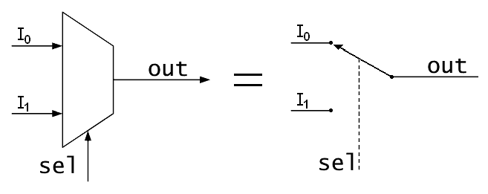
Reference (1)
The address/data bus on the 8086 is multiplexed (shared) to reduce the number of pins required for the 8086/8088 microprocessor integrated circuit. Unfortunately, this burdens the hardware designer with the task of extracting or demultiplexing information from these multiplexed pins.

Slide 12
Reference (2): Multiplexer (Data Selector)
Multiplexing means transmitting a large number of information units over a smaller number of channels or lines.
A digital multiplexer is a circuit that selects binary information from one of many input lines and directs it to a single output lines.
The selection of a particular input line is controlled by a set of selection lines.
Have 2^{n} input lines and n selection lines whose bit combinations determine which input is selected.

Slide 13
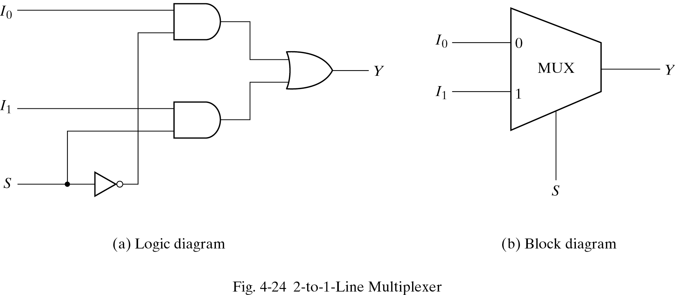
Reference (3): Multiplexer

Slide 14
Reference (4) : 4-to-1-Line Multiplexer
The combinations of S₀ and S₁ control each AND gates
Part of the multiplexer resembles a decoder
Selection lines s₁ and s₀ are decoded to select a particular AND gate.
To construct a multiplexer:
Start with an n-to-2^{n} decoder
Add 2^{n} input lines, one to each AND gate
The outputs of the AND gates are applied to a single OR gate.

Slide 15
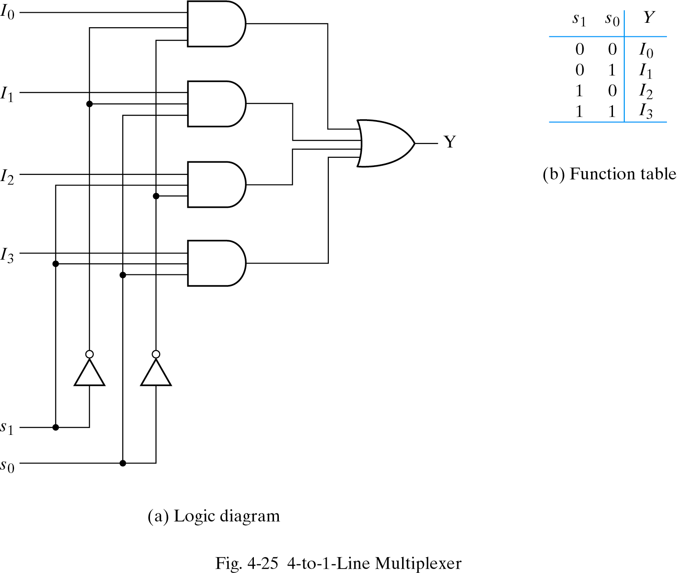
Reference (5) : 4-to-1-Line Multiplexer
The function table lists the input-to-output path for each possible bit combination of the selection lines.

Slide 16
Reference (6): Multiplexer
The size of a multiplexer is specified by the number 2^{n} of its input lines and the single output line.
It is then implied that it also contains n selection lines.
As in decoders, multiplexer ICs may have an enable input to control the operation of the unit.

Slide 17
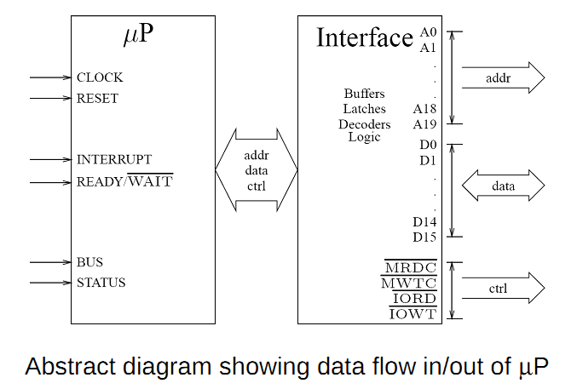
Reference (7)

Slide 18
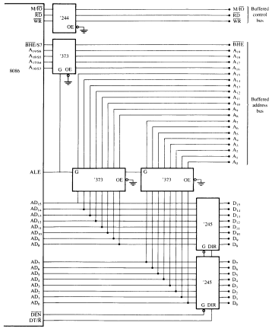
BUS Buffering and Latching
Reference (8)
The 8086 microprocessor shown with a demultiplexed address bus. This is the
model used to build many 8086-based systems
ALE =1 then this address lines will go to bus also as
AD0 to Ad15 connect to 373 buffers, addresses will
Go to bus.By disabling DEN pin we disable 245 buffers.So
From 0 to 15 nothing pass as data
When ALE =0 then from AD0 to Ad15 we get DATA.Then DEN
Pin enables and 245 buffers become active so 0-15 send
Data to bus

